Slide 1
JUKTOFRONT ELECTION 1954

Slide 2
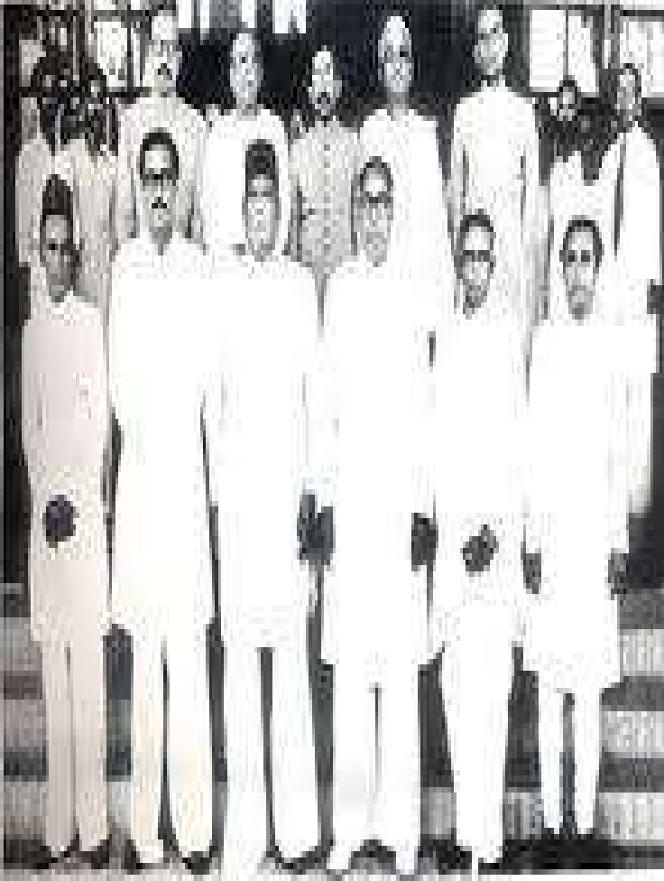
Discussion point
Introduction
Alliance of United front.
Twenty-One Point Program.
Result The Election In 1954.
Importance of Election in 1954.
Rise of United Front in1954 Election.
Fall of Muslim League Election in 1954

Slide 3
□The first election of East Bengal
Election in 1954
Legislation was held in March 1954 under the India Act of 1935. The contesting parties in the elections were the ruling Muslim League and a four - party alliance called United Front (Juktofront).

Slide 4
□ From Juktofront election to the election of 1970 have consists the actual preparation to be freedom of Bangladesh. The election of 1954, 6 point movement of 1966 and mass up rival of 1969 plays the vital role to make the people involve in liberation war of 1971.

Slide 5
The major partners of the front were the Awami League led by Abdul Hamid khan Bhasani, the Krishak Sramik Party led by AK Fazlul Haq, Nezam -E islam led by Maulana Athar Ali, and Ganatantri Dal led by Haji Mohammad Danesh.

Slide 6
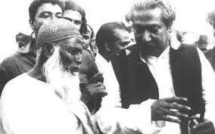
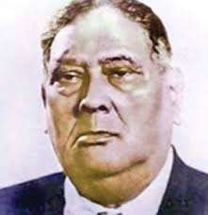
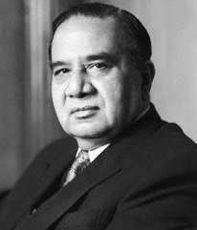
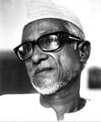
INTRODUCTION

Slide 7


Alliance of United front.
AWAMI MUSLIM LEAGUE(Maulana Abdul Hamid Khan Bhasani)
2.Krishak SramikParty,(A.K.F. Haqe)
Nizam-e-Islam,(Mawlana Athar Ali)
Ganatantri Dal.(HaziDanesh)

Slide 8
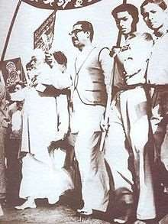
RISE OF UNITED FRONT (1954 ELECTION)
CREATE A STRONG ALLIANCE
STRONG LEADING AND POLICY
TWENTY-ONE PROGRAMED OF UNITED FRONT
THE STATEMENT/POSITION OF STATE LANGUAGE

Slide 9
FALL OF MUSLIM LEAGUE ELECTION IN 1954
THE INTERNAL CONFLICT OF MUSLIM LEAGUE
FAILED OF GOVERN IN THE STATE
THE POLICY OF DOMINATION OF MUSLIM LEAGUE
THE DISCRIMINATION TWO PART IN PAKISTAN:
TO FAILED APPROVED IN CONSTITUTION

Slide 10
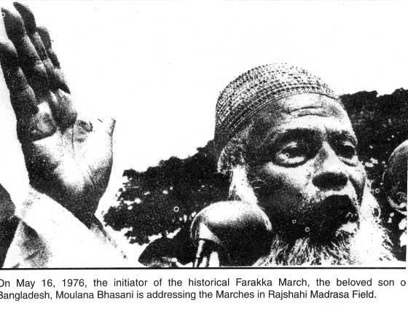
Abdul Hamid khan Bhasani

Slide 11
Election Issue of Juktofront
□The United Front campaigned on an election manifesto consisting of 21 point. This point contains the agriculture, industries and socio-economic development of East Bengal.

Slide 12
TWENTY-ONE POINT PROGRAM
It also called for recognition of Bangla as a state language
release of political prisoners,
transformation of the then official residence (Burdwan House) of the chief minister of East Bengal into Bangla Academy,
construction of Shaheed Minar at the site of the police firing in 1952,
declaration of 21 February as a public holiday,
more autonomy for Dhaka and Rajshahi universities,
introduction of economic and social rights for industrial
workers in keeping with the principles of ILO,
nationalization of jute, guarantee of fair prices for commodities, and public support for cooperatives and cottage industries.

Slide 13
The 21-point also demands the independence of East Bengal.
It also mentioned the declaration of Bangla as state language,
21 February as Martyrs day and public holiday,
Build Shahid Minar in memory of language martyrs.
Nationalize of salt cultivation and cottage industries in East.

Slide 14

Election Issue of Muslim League
□ On the other hand the Muslim Leagues election issues were on religion based. They said that if Pakistan were destroy then Muslim would destroy. They also said that either Pakistan a Muslim country or not will determined by this election. As here contest a Muslim party in one hand and opposite are those who does not want Pakistan a Muslim state.

Slide 15

Result
□ The elections resulted in a landslide victory for the United Front which won 228 among 309 seats,(including 9 reserved seats for women) Muslim League won 9 seat, Khalafat Rabbani won only 2 seat and non party won 12 seats. Among the 72 reserved seats for non-Muslim, congress won 25, Tapshil Federation 27 United Front minorities 13.
(Source: Banglapedia, Election, pp 134)

Slide 16
Cause for defeat of Muslim League
The ruling Muslim league which was in power directly or indirectly ever since 1937, defeat in the election of 1954 for mainly three causes. These are
a) Cultural causes
b) Political causes
c) Socio- Economic causes

Slide 17
After the result
□ 24 October 1954
Pak general
Golam Mohammed
departs of
Mass Assemble and declare emergency. He formed a ministry with Ayub Khan, Iskandar Mirza, khan shaeb and later Sharawardy as law ministry.

Slide 18
IMPORTANCE OF ELECTION IN 1954:
Bengali nationalism won this election. This election especially rises of a secularist political ideology. United front and their ally are also growth secularist ideology which are accepted people .at least the win united front.
The win
of the united front demand rises to the full
autonomy in this province and it also main agenda of united front.
In 1954 we show that the influence middle stage people, political (this election majority of the candidate are are a middle knowledge in political background
The result in 1954 are deeply demand full autonomy, and it was a great role ply in this election.
In 1954 election were end the Muslim league govern.in this election people are show read card Muslim league.

Slide 19
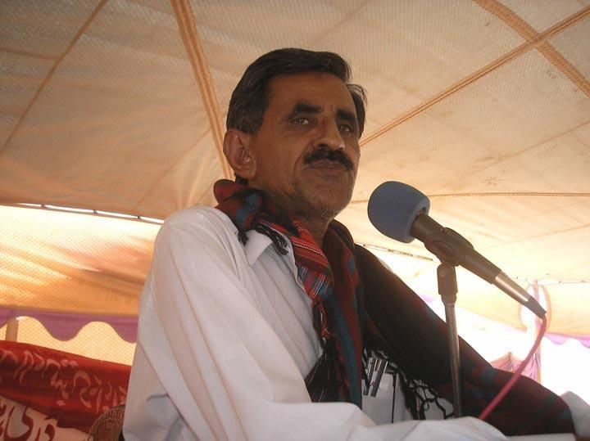
General Ghulam Mohammed

Slide 20
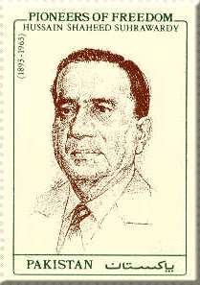
Hossain shahid Suhrawardy

Slide 21

Constitution of Pakistan in 1956
□ In 9 January, 1956 a constitutional bill was arise in mass assemble which was accepted in 29 February. This constitution declares Pakistan as the Islamic Republican state. The constitution deserves the post of president only for Muslim. In 23 March 1956 the new constitution was effected. Iskandar Mirza elected as
first president.

Slide 22
□ In 7 October 1958, president Mirza imposed marshal law and banned all political activities. He also dismissed the constitution and appointed Ayub Khan as the chief of army. Later Ayub khan took the state power and left Mirza at 27 October. The marshal law was continuing since 1962.

Slide 23
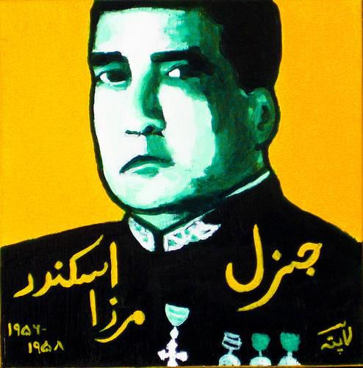
Iskandar Mirza

Slide 24
Ayub Regime
□ After taking state power, Ayub Khan introduces a fundamental democracy. He imposes a new constitution at 1 march 1962 on his own choice. This institution was not accepted by East Bengal. In 1964-65, an election was held under this constitution.

Slide 25
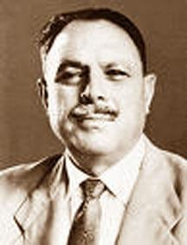
Ayub Khan

Slide 26
Questions
□ 1
What do you understand by Juktofront?
What was the result of Juktofront Election in 1954?

